Slide 1
Simple Deterministic Wildcard Matching
Peter Clifford and Raphaël Clifford
Information Processing Letters, Vol. 101, pp. 53-54, 2007
Presenter: Yung-Hsing Peng
Date: June 27, 2007

Slide 2
Abstract
We present a simple and fast deterministic solution to the string matching with don’t cares problem. The task is to determine all positions in a text where a pattern occurs, allowing both pattern and text to contain single character wildcards. Our algorithm takes O(nlogm) time for a text of length n and a pattern of length m and in our view the algorithm is conceptually simpler than previous approaches.

Slide 3
Example for the Problem
T = 13.342..142
P = 4.4.14
The symbol “.” means don’t care
T
1 | 3 | . | 3 | 4 | 2 | . | . | 1 | 4 | 2
P
4 | . | 4 | . | 1 | 4
Match
P
4 | . | 4 | . | 1 | 4
Match
P
4 | . | 4 | . | 1 | 4
Mismatch
Goal: Determine all matched positions of P in T.

Slide 4
Main Idea
The authors propose their algorithm by adapting the method for exact matching.
Important tools: Convolution & FFT

Slide 5
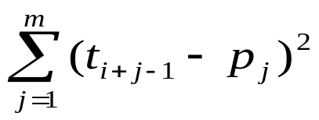
The Idea of Exact Matching (1/2)
t₁ | t₂ | t₃ | t₄ | t₅ | t₆ | t₇ | t₈ | t₉ | t₁₀ | t₁₁
T
x₁ | x₂ | x₃ | x₄ | x₅ | x₆ | x₇ | x₈ | x₉ | x₁₀ | x₁₁
p₁ | p₂ | p₃ | p₄ | p₅ | p₆
P
y₁ | y₂ | y₃ | y₄ | y₅ | y₆
Match?
D
d₁ | d₂ | d₃ | d₄ | d₅ | d₆ | d₇ | d₈ | d₉ | d₁₀ | d₁₁
d₃ = (t₃ - p₁)² + (t₄ - p₂)² + (t₅ - p₃)² + (t₆ - p₄)² + (t₇ - p₅)² + (t₈ - p₆)²
d_{i} = (t_{i} - p₁)² + (t_{i+1} - p₂)² + (t_{i+2} - p₃)² + (t_{i+3} - p₄)² + (t_{i+4} - p₅)² + (t_{i+5} - p₆)²
If d_{i} = 0, then there is a match at position i.
More precisely, we have d_{i} =
Straightforward implementation takes O(nm) time!

Slide 6
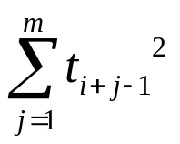
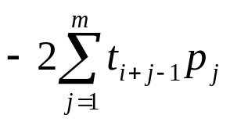
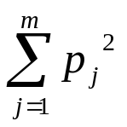
The Idea of Exact Matching (2/2)
a_{i} = b_{i} = c_{i} =
We have d_{i} = a_{i} + b_{i} + c_{i}
Computing time for each d_{i}:
a_{i} and c_{i} → constant time with window sliding
b_{i} → O(m) time with window sliding
b_{i} is the bottleneck which leads to O(nm)-time implementation.

Slide 7
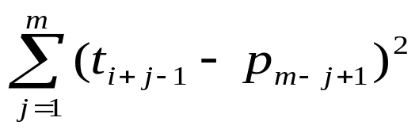
Exact Matching with Convolution (1/2)
t₁ | t₂ | t₃ | t₄ | t₅ | t₆ | t₇ | t₈ | t₉ | t₁₀ | t₁₁
T
x₁ | x₂ | x₃ | x₄ | x₅ | x₆ | x₇ | x₈ | x₉ | x₁₀ | x₁₁
p₁ | p₂ | p₃ | p₄ | p₅ | p₆
P^{R}
y₆ | y₅ | y₄ | y₃ | y₂ | y₁
Match?
D
d₁ | d₂ | d₃ | d₄ | d₅ | d₆ | d₇ | d₈ | d₉ | d₁₀ | d₁₁
d₃ = (t₃ – p₆)² + (t₄ – p₅)² + (t₅ – p₄)² + (t₆ – p₃)² + (t₇ – p₂)² + (t₈ – p₁)²
d_{i} = (t_{i} – p₆)² + (t_{i+1} – p₅)² + (t_{i+2} – p₄)² + (t_{i+3} – p₃)² + (t_{i+4} – p₂)² + (t_{i+5} – p₁)²
If d_{i} = 0, then there is a match at position i.
Here we have d_{i} =

Slide 8
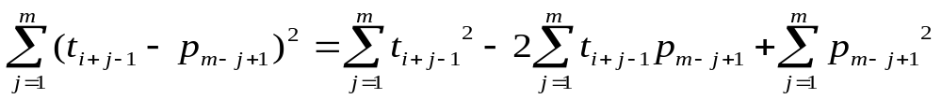
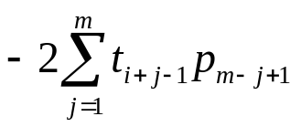
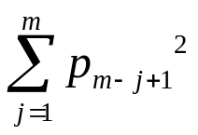
Exact Matching with Convolution (2/2)
a_{i}’ = b_{i}’ = c_{i}’ =
Now we have d_{i} = a_{i}’ + b_{i}’ + c_{i}’
Computing time for each d_{i}:
a_{i}’ and c_{i}’ → constant time with window sliding
b_{i}’ → Convolution
However, a straightforward computation for all b_{i}’ still leads to an O(nm)-time algorithm.

Slide 9
The Usage of FFT
To obtain the sequence B’ = b₁’b₂’…b_{n-m+1}’ which is the convolution of sequences T and P^{R}, we can use the theorem:
B’ = CONV(T, P^{R}) = FFT⁻¹( FFT(T) • FFT(P^{R}) )
CONV: Convolution
FFT: Fast Fourier Transform
FFT⁻¹: Inverse Fast Fourier Transform
Note that the inner product can be done in O(n) time.
It takes O(nlogn) time to obtain B’, since both FFT and FFT⁻¹ require O(nlogn) time. (Divide and Conquer)
→ We obtain an O(nlogn)-time algorithm for exact matching.

Slide 10
Some Tips
Before using FFT, remember to pad some zeros on P if it is shorter than T. (otherwise we cannot perform the inner product)
Exact string matching with FFT seems useless since we already have the well known KMP algorithm.
However, when it comes to string matching with don’t cares, FFT is still the best-known method.

Slide 11
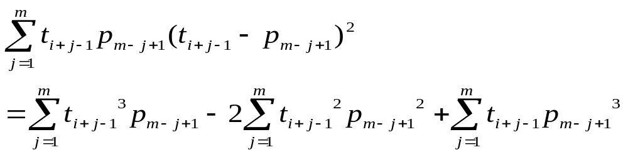
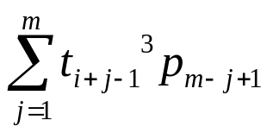
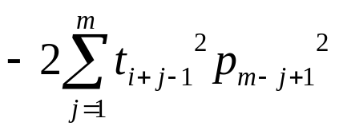
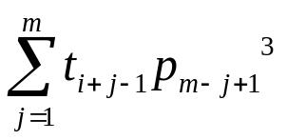
String Matching with Don’t Cares
Transform T into a string over {0, 1, 2, 3, …, n}, where 0 denotes the dot character. Then, the formula can be written as follows.
a_{i}’ = b_{i}’ = c_{i}’ =
d_{i} = a_{i}’ + b_{i}’ + c_{i}’ → Computing D takes O(nlogn) time (Convolution)
If d_{i} = 0, then there is a don’t care match at position i.

Slide 12
A Trick for Further Improvement
The required time can be reduced from O(nlogn) to O(nlogm)
T
P
Split it to O(n/m) blocks of length m
For every two consecutive blocks, solve the don’t care matching problem with P in O(mlogm) time.
→ The overall time complexity is O((n/m)×mlogm) = O(nlogm)

Slide 13
Conclusion
Based on FFT, the authors propose a simple algorithm for solving the string matching problem with don’t cares in O(nlogm) time.
For this problem, O(nlogm)-time algorithms are the best known results.
Future Works:
(1)Efficient preprocessing for string matching with don’t cares?
(2)KMP-based algorithm for string matching with don’t cares?
(3)2D string matching with don’t cares?

